Slide 1
Parent Drop-Off
There are two drop-off locations marked by a yellow star.
Front office parking lot located off 58th Street South.
South Parking lot located off 11th Avenue South.
Please do not drop off students in areas enclosed by red squares.

Slide 2
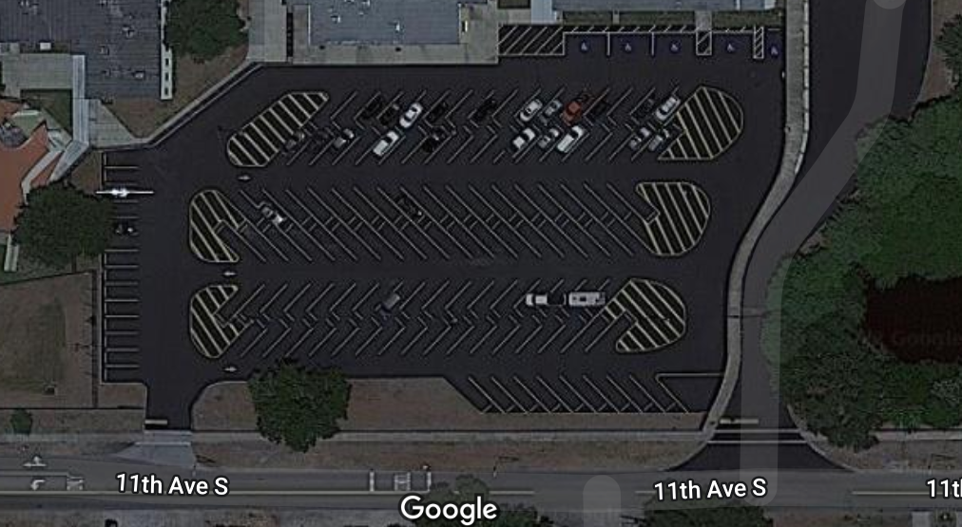
South Parking Lot
Follow circle around to yellow star. This is the only open gate for students to enter campus.

Slide 3
58th Street Drop-Off
Enter parking lot through 58th street.
Only drop-off students by yellow stars (front office/auditorium).
These are the only open student entrances.
All other gates will be close.

Slide 4
Smooth Sailing
Gentle reminders for smooth sailing.
Do not park or idle in drop-off lane
Have students get prepared for drop-off prior to entering the parking lots.
Back-up begins around 6:55 a.m.
Do not speed!

